Slide 1


SMART PORTABLE PATIENT MONITORING DEVICE
SIVANAHUL R (211EC519)
TARUN N (201EC270)
THISHON J (201EC275)

Slide 2
Abstract:
In recent days, the cardiovascular disease problem has been so high in the entire world. There are
well understood early symptoms of cardiovascular diseases, such as heart attack, stroke, and hypertension, which are caused by disorders of the heart and blood vessels that could be used to greatly help in saving many lives and minimize damages by detecting and reporting at an early stage.
This device can help in reducing the number of deaths by this type of disease. The World Health Organization says that an estimated 17 million people die each year from cardiovascular disease.
A portable device to monitor a patient remotely is one of the solutions to this problem. The portable device discussed here will continuously monitor the patient and inform their status to the respective authority and also to the doctors under whom this patient is taking medication.
This device is a type of ambulatory electrocardiography device, which is used to monitor the electrical activity of the heart along with heart rate and oxygen level. Data is extracted from the sensor modules and stored. To make the system real-time, a
GSM module to upload data on the cloud is incorporated.
By monitoring these biomedical data doctors can easily support the patients for medication based on the severity. If a patient feels an abnormal
condition and wants to check current data for that purpose LED display is used. The system is a compact device for predicament situations, low cost, and real-time monitoring is available.

Slide 3
Problem Statement Addressed
Holter monitors don't give real-time results. It may take one or two weeks. So, in this project, we made the system in real-time and got results earlier.
Experiments show that the proposed SQA method outperforms existing methods based on morphological and RR interval features, as well as machine learning approaches, in recognizing the unacceptable quality of ECG data [1].
The IoT- based gadgets are more human-friendly than the Holter Monitor because they have fewer cords and smaller sizes, and they create fewer disturbances to patients' everyday activities.

Slide 4
Existing Solution to the Problem Addressed
The proposed system named IoT-based portable device Monitor gives appropriate
data. The major parameters considered to make a complete Holter monitor are heart
rate, ECG signal, and oxygen percentage in blood.
The biomedical data of heart rate and ECG signals
are proper. The system is very lightweight and low cost. We are storing biomedical
data on an SD card as well as displaying it on an OLED display. Data stored in SD
cards will help doctors to diagnose diseases of patients and OLED displays will
give the current status of parameters to patients.
We claim that from the sensors, the
data obtained are stored in the cloud using the IoT concept and the output of sensors
is processed to find the normal and abnormal conditions of the patients based on the
predefined threshold values.
The
information about the patient's health condition will be displayed in the LCD and an
alert will be given if an abnormal condition arrives messages will be sent to the
caretaker, physician, and ambulance based on the condition of the patient which has
arrived from the diagnosis part of the device.

Slide 5
Proposed Solution to the Problem Addressed
The proposed system is a complete Holter monitor, which is used for cardiac monitoring. The Holter monitor is manually used for monitoring ECG, but in this system, we included three more parameters.
Heart rate and oxygen percentage present in the blood are the major parameters and are much important in the diagnosis process. Also includes three modules to calculate heart rate, ECG signal, and oxygen percentage in blood.
To compute a patient's heart rate, the
system can detect QRS complexes and count heartbeats for one minute. In the smart ECG Holter, a mechanism for robustly classifying ECG into one of three major kinds of arrhythmias was devised[2]. There are many different ways to calculate heart rate, and in this project, we built one algorithm which takes heartbeats for 15 sec and converts it to BPM.
The output of the ECG module is
an analog signal. So, we can directly store ECG into an SD card and display it on OLED. Pulse Oximeters are used to measure oxygen percentage in blood. The suggested quality-aware ECG telemetry system also saves energy consumption by broadcasting good ECG signals and placing IoT devices into sleep mode for poor ECG signals, according to real-time evaluation results [3].
A data cleansing module
and a heartbeat classification module make up the framework. It takes raw ECG readings from various IoT devices as input and produces predictions for individual heartbeats as output [3]. A telemedicine system is a highly effective approach to connect
patients with their doctors at any time and from any location. In reality, this proposed solution makes use of IoT-based technology [4].

Slide 6
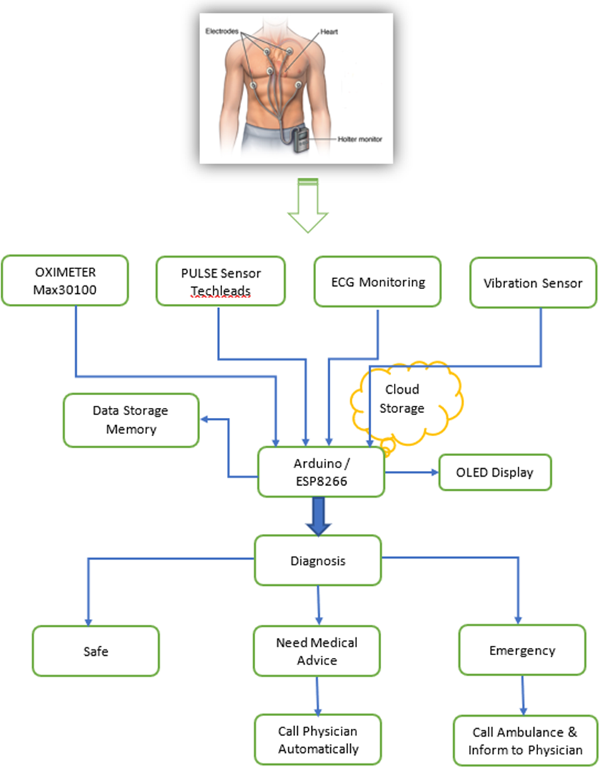
Block Diagram and/or Circuit Diagram

Slide 7
Technology stack & use case

Slide 8
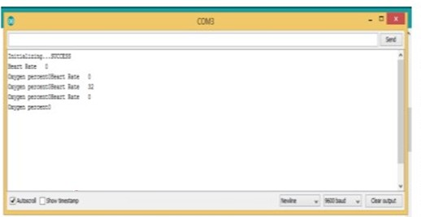
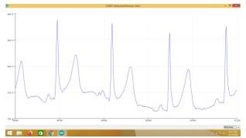
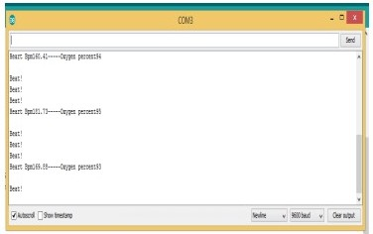
Prototype & Sample Output
Fig -1: Heart rate and Oximeter readings
Fig -2: Analog output of ECG sensor module
Fig -3: Output of pulse Oximeter

Slide 9
Analysis of Results & Discussions
The system includes three modules to calculate
heart rate, ECG signal, and oxygen percentage in blood. An Arduino microcontroller is used to acquire and
process the information from the modules. There are many different ways to calculate heart rate, and in this
project, we built one algorithm which takes heartbeats for 15 sec and converts it to BPM.
The output of the ECG module is an analog
signal. So, we can directly store ECG and display it on OLED. The proposed system named IoT-based
portable device Monitor gives appropriate data. The major parameters considered to make an innovative Holter monitor are heart rate, ECG signal, and oxygen percentage in blood.
The biomedical data of heart rate and
ECG signals are proper. The system is very lightweight and low costs as well as we are using predicament situations. We are storing biomedical data on an SD card as well as displaying it on an OLED display.
Data stored in SD
cards will help our doctors to diagnose diseases of patients and OLED displays will give the current status
of parameters to patients. Furthermore, a vibration sensor is activated and transfers the messages through the GPS and GSM modules. Any kind of critical stages occurred as the location can be found easily.

Slide 10
References
[1]Prachi patil, Swapnil Patil, Gaurav Parab, Mugdha Salvi, Ananthu Nair,”IOT based Patient Health Monitoring System”,International Research Journal of Engineering and Technology (IRJET), e-ISSN: 2395 - 0056, Volume: 04, Issue: 03 , P.No.2316-2319, Mar -2017.
[2]PrachiKamble,”IoT Based Portable ECG Monitoring Device for Smart Healthcare”,IEEE 5th International Conference on Science, Technology, Engineering and Mathematics – ICONSTEM, ICON EECIS - 19, P.No.1- 4, 2019.
[3]MateoSokač, “A New Design for a Holter Monitor Based on Internet of Things Technology”, IEEE- Citation-StyleGuide, Rochester Institute of Technology, Zagreb, Croatia - IEEE, P.No. 2-5, 2018.
[4]Sharvari.M.Kallole, “Subjective scoring of cough in children: parent-completed vs child-completed diary cards vs an objective method”, Journals Ltd 1998 European Respiratory Journal ISSN 0903 - 1936, P.No. 463-465, 2021
[5]LamiaNabilMahdy, “Smart ECG Holter Monitoring System Using Smartphone”, The 2018 IEEE
International Conference on Internet of Things and Intelligence System (IoTaIS), P. No 80-84, 2018.

